Slide 1
CS Project: SHSID Campus Navigation
Yu Ming Law 10(10)

Slide 2
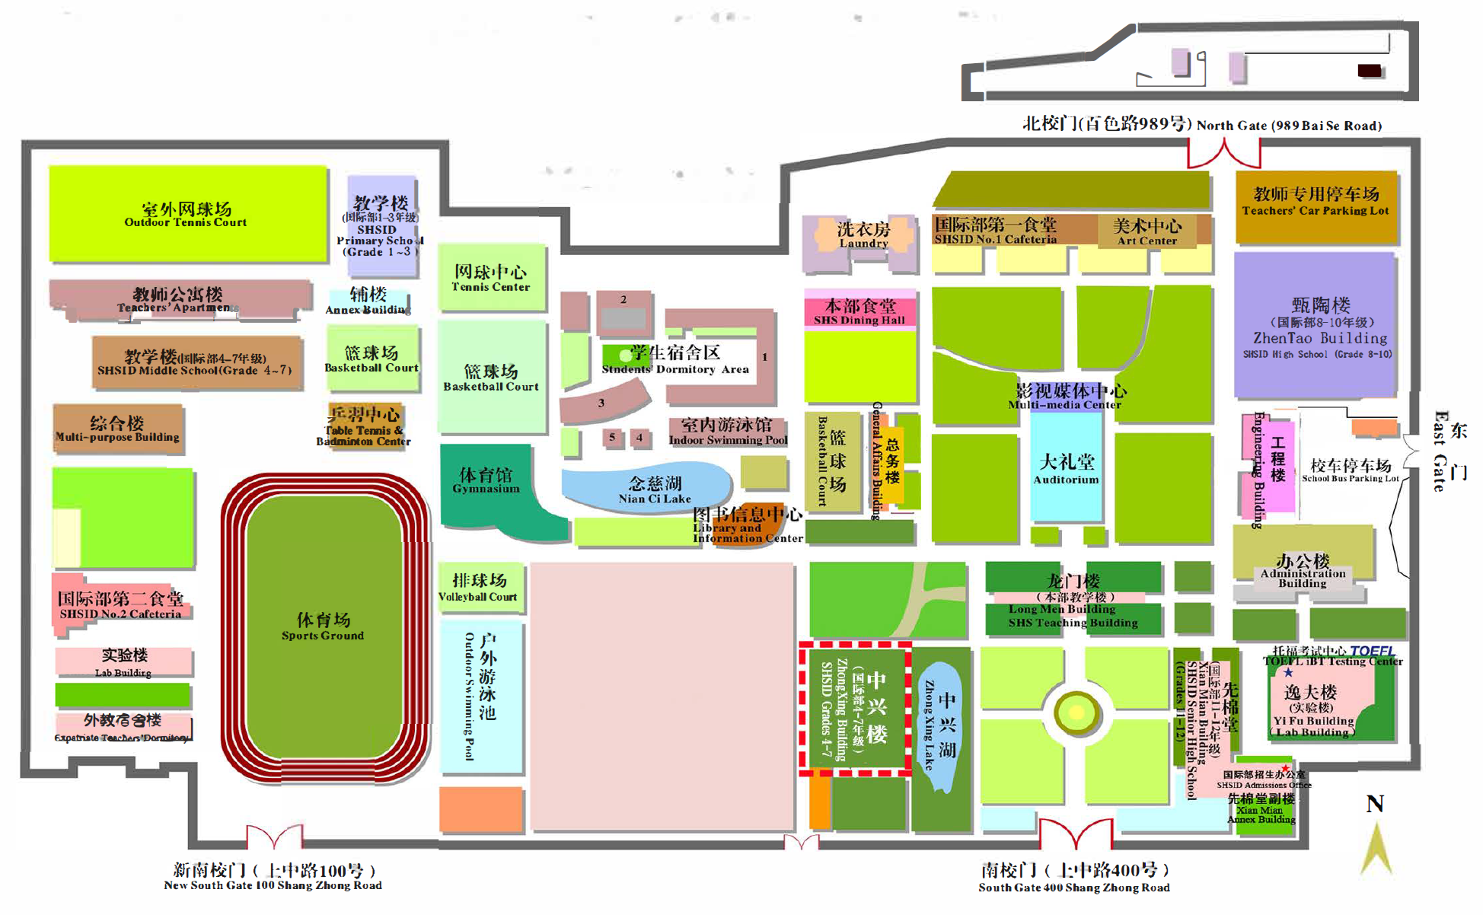
Defining the problem
SHSID Campus is huge (approx. 200,000 sq. meters)
Parents that are not familiar with the campus struggle to find their way
Baidu Map / Amap fails due to insufficient data about specific buildings in SHSID Campus.
Suggestion from Mom

Slide 3
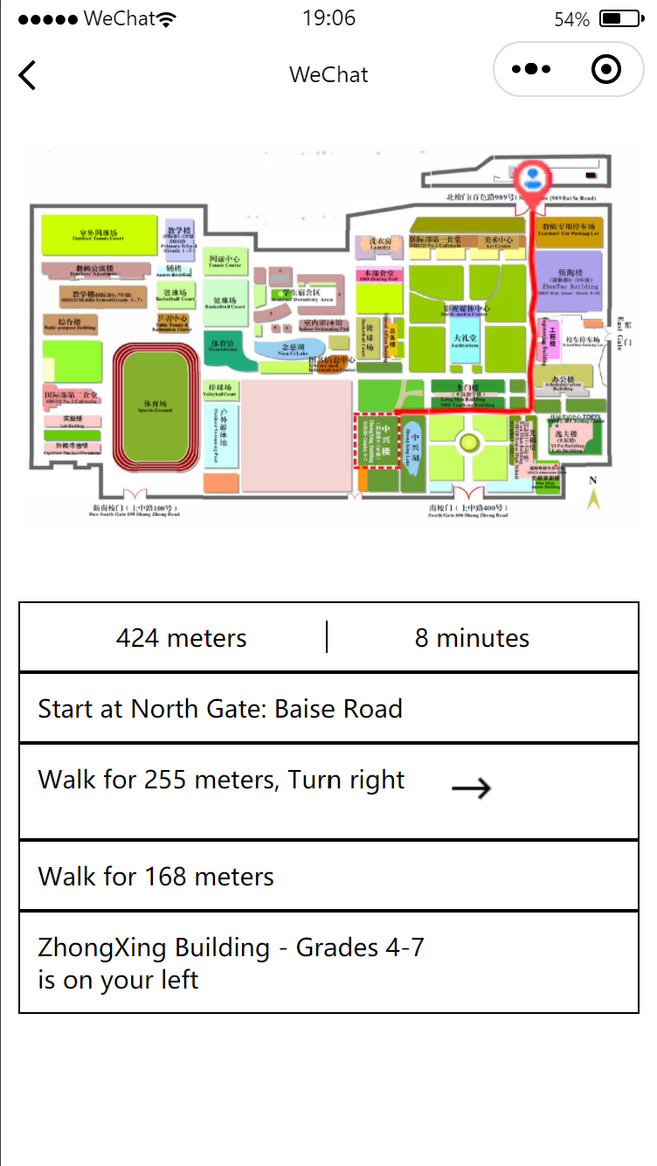
Solution
Designed a navigation specifically for SHSID parents
User selects starting point and ending point
Program outputs:
Time
Distance
Shortest route with instructions
Traced route on map

Slide 4
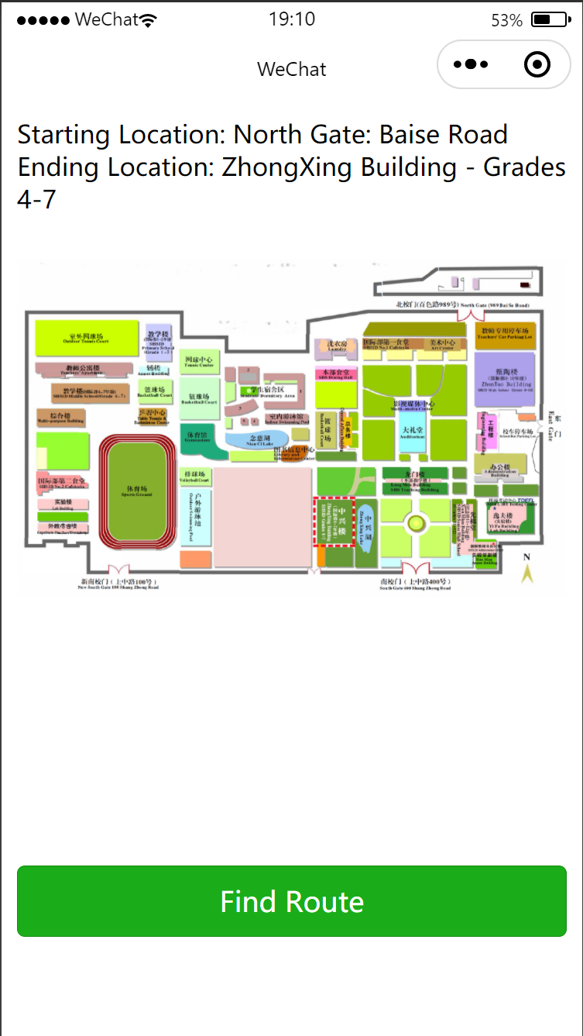
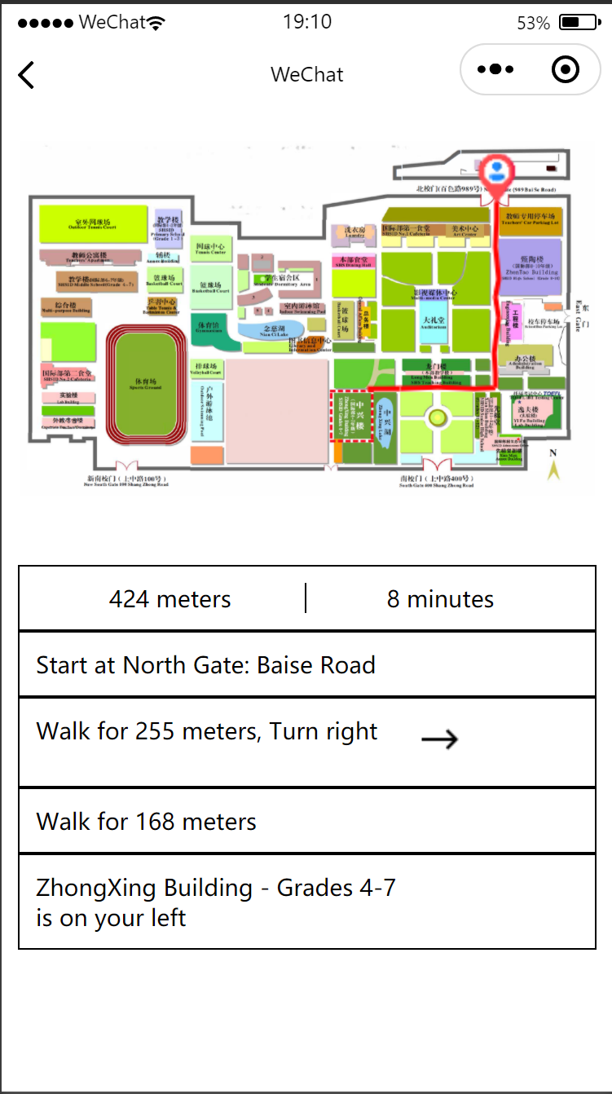
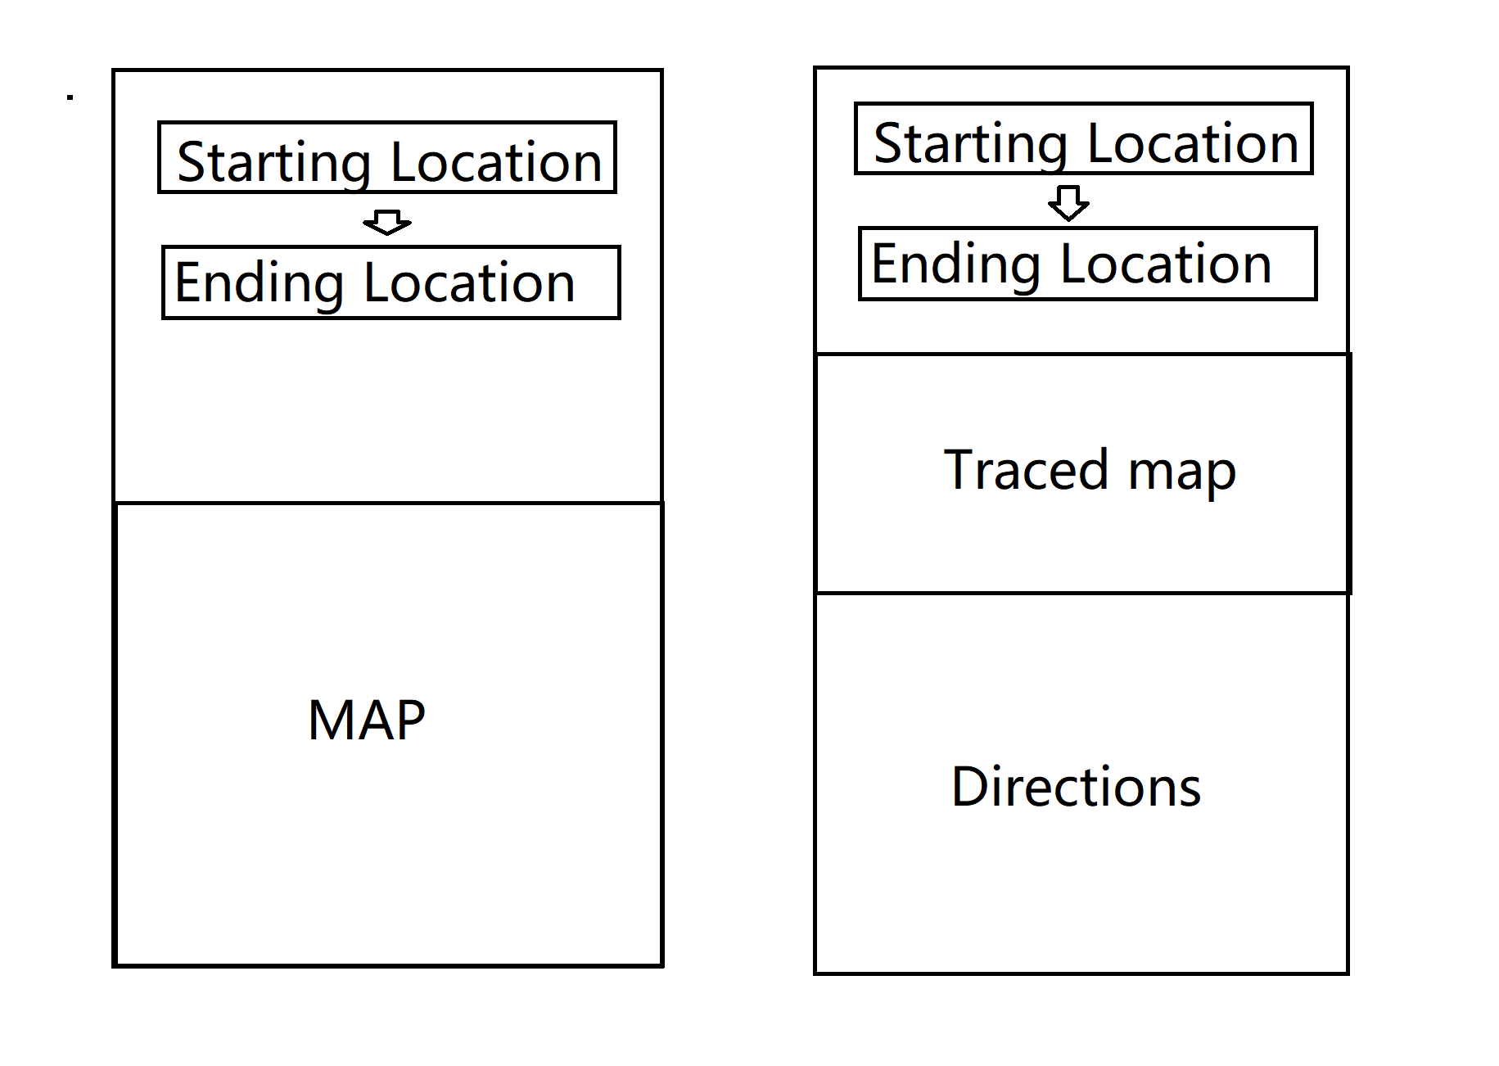
Interface Design

Slide 5
Program Design
WeChat Mini Program:
WXML for interface coding
Js for calculations controlling the interface
WXSS for styles
Bellman Ford Algorithm
Finds the shortest route between two nodes in an adjacency list
Data structures:
Array – adjacency list for nodes
Dictionary – store nodes for buildings, and their respective coordinates
Naming Rule: camel case naming convention

Slide 6
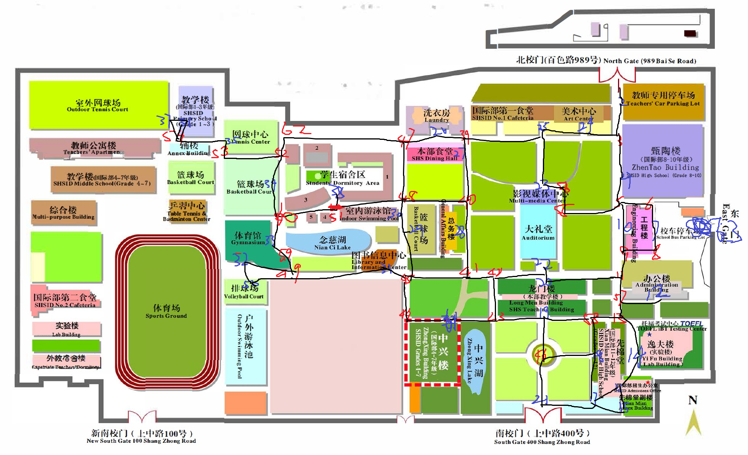
Implementation
Step 1: Use WXML to design UI
Step 2: Draw all nodes, get relative distance, create an adjacency list to store distance between every two nodes
Step 3: Modify Bellman-Ford algorithm to suit my needs -> get shortest route between any two nodes

Slide 7
Implementation (Continued)
Step 4: Get relative coordinates of each nodes to draw the route.
Step 5: Beautify the Mini Program
Program is fully functional

Slide 8
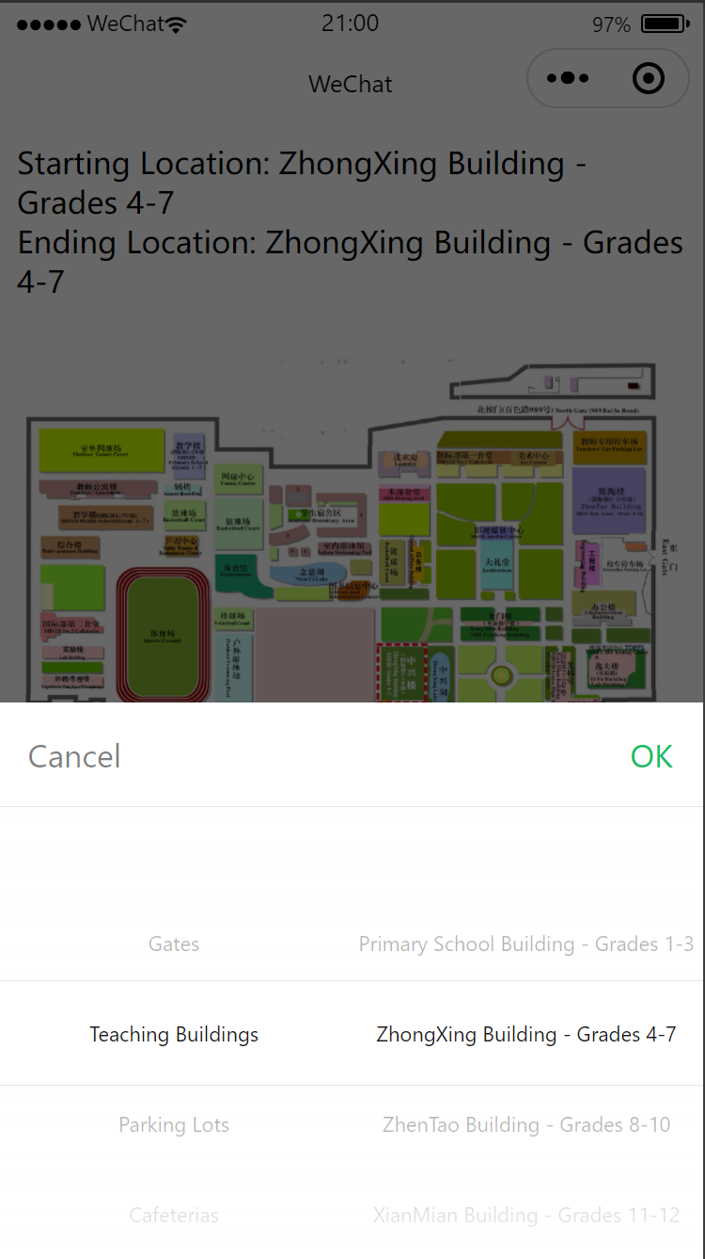
Analysis on result
Assumptions:
User walks at casual pace, 1m/s
There is no traffic in the school during the day
All roads are open for user to walk at
Benefits:
User can zoom in and out for the map.
User can select starting point / ending point based on categories, in case they are not familiar with the school

Slide 9
Analysis on result
Drawbacks:
No live location provided
Only one route shown
Distances are calculated by relative distance -> inaccuracy
Currently on supports English
Improvements:
Add floor plans, navigate user through each building to the specified room
Add more routes
Add more languages
Add live location

Slide 10
Thank you for listening

